Slide 1
電腦視覺原理及應用簡介
Lab1
Read/Write Images and Videos

Slide 2
Course Information
Lecture: Thursday 13:00~15:00
Lab: 8 times (6:00pm~9:00pm)
Reference books:
  R. C. Gonzalez, R. E. Woods, Digital Image Processing, Prentice-Hall
  Shapiro and Stockman, Computer Vision, Prentice-Hall
TA:
  張至妤 chihyuuuu@gmail.com
  王心妙 five998546@gmail.com
  吳泰德 f0966066981@gmail.com
  黃宇睿 alucard6686@gmail.com

Slide 3
Lab Sessions
Upload your file including code and result image after your work is checked by TA.
If you can not finish your work in time, let the TA know your name and make sure you have attended the lab session.
If you cannot finish the lab in time (before 9:00pm), we accept make-up results within one week and you can get 70% score.
  Make-up time :
    Tuseday 12:00 – 13:00, at A308
We do not accept make-up demos if you did not attend the lab sessions.
Notes:
助教檢查完後，用壓縮檔上傳到LMS 。
沒做完的同學 ，lab session結束前點名確認，一週內補交心得(沒做完的原因 及 解決問題的過程)及程式 。
沒到的同學不接受補交
上傳時間為一個星期

Slide 4
Development Environment
OS: Windows 10
Programming Language: Python
Library : OpenCV
  How to install opencv library for python?
    Open Command(or a PowerShell) window
    Insert the command “pip install opencv-python”

Slide 5
Intro to OpenCV
OpenCV is an image processing library
Available on Mac, Windows, Linux
Works in C, C++, and Python
Open Source and free.
Easy to use and install

Slide 6
Images

Slide 7
How to Read/Write image
Read
  cv2.imread(file_Name, flag)
    filename: the image should be in the working directory or a full path of image should be given
    flag: the way image should be read, including ‘cv2.IMREAD_COLORD’, ‘cv2.IMREAD_GRAYSCALE’, ‘cv2.IMREAD_UNCHANGED’
Display
  cv2.imshow(‘window_Name’, image)
Write
  cv2.imwrite('messigray.png',image)
Notes:
Filename: 檔案路徑
Flag: 圖片的格式
cv2.IMREAD_COLORD -> 此為預設值，這種格式會讀取圖片的RGB 三個 channels的值 ，所以圖片可以是彩色的。
cv2.IMREAD_GRAYSCALE -> 以灰階的格式來讀取圖片。
cv2.IMREAD_UNCHANGED -> 用圖片原來的格式讀取。

Slide 8
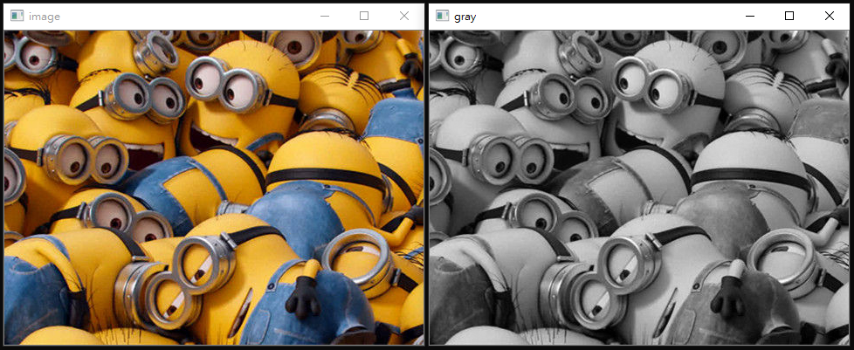
Demo
RGB to Grayscale

Slide 9
How to convert RGB to Grayscale?
Import main library
Read the image
Do the processing
Show the image
Close and exit

Slide 10
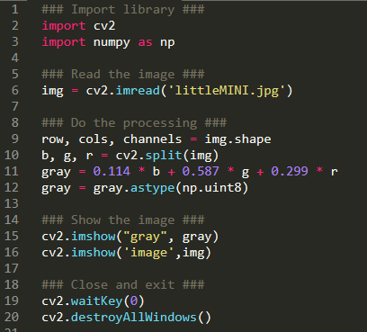
Cont.
Notes:
.shape 圖片長、寬、channel數
cv2.split() 函數可分離出圖片的各個channel
cv2.waitKey 函數是用來等待與讀取使用者按下的按鍵，而其參數是等待時間（單位為毫秒），若設定為 0 就表示持續等待至使用者按下按鍵為止
cv2.destroyAllWindows 關閉所有 OpenCV 的視窗。
cv2.destroyWindow('My Image’) 關閉指定的視窗

Slide 11
Videoes

Slide 12
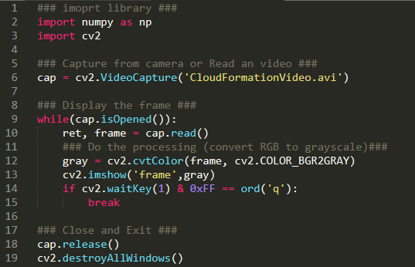
How to Read/Display video
Notes:
cap.read() returns a bool (True/False). If frame is read correctly, it will be True. So you can check end of the video by checking this return value.
Cap.read():
ret = ture/false
frame = image
Ord() 轉成8位的ASCII碼
0xFF 的存在是為了防止BUG，在某些系統上ASCII碼位數不只8位
Release() Closes video file or capturing device.
1. waitKey(0) will display the window infinitely until any keypress (it is suitable for image display).
2. waitKey(1) will display a frame for 1 ms, after which display will be automatically closed

Slide 13
Assignment
請至LMS下載影片
利用 OpenCV 讀取影片，並將影片轉為灰階
在影片播放時，可以有以下四個功能：
  按 r 的時候，可以將此刻的影片存成紅色圖片
  按 g 的時候，可以將此刻的影片存成綠色圖片
  按 b 的時候，可以將此刻的影片存成藍色圖片
  按 q 的時候，關閉影片
p.s.播放影片時的window name 和存圖片的檔名請加上自己的姓名和學號 e.g. 學號_姓名_Capture_r.png
Notes:
https://www.onlinevideoconverter.com/zh/youtube-converter

Slide 14
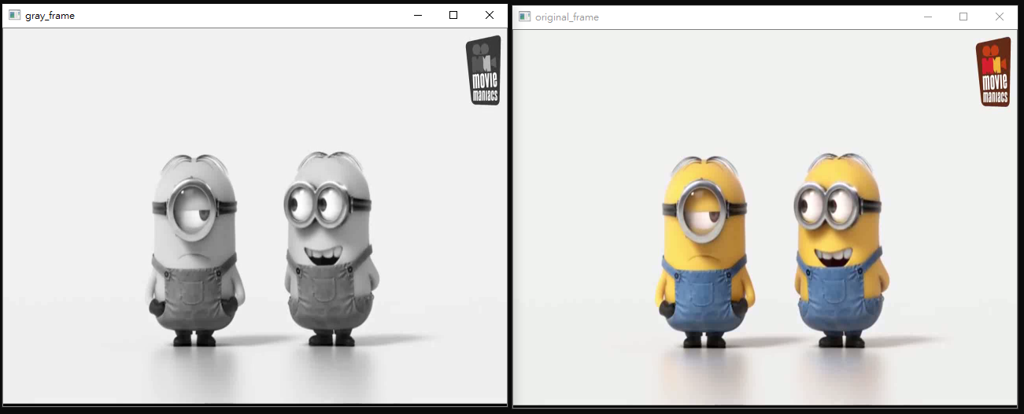
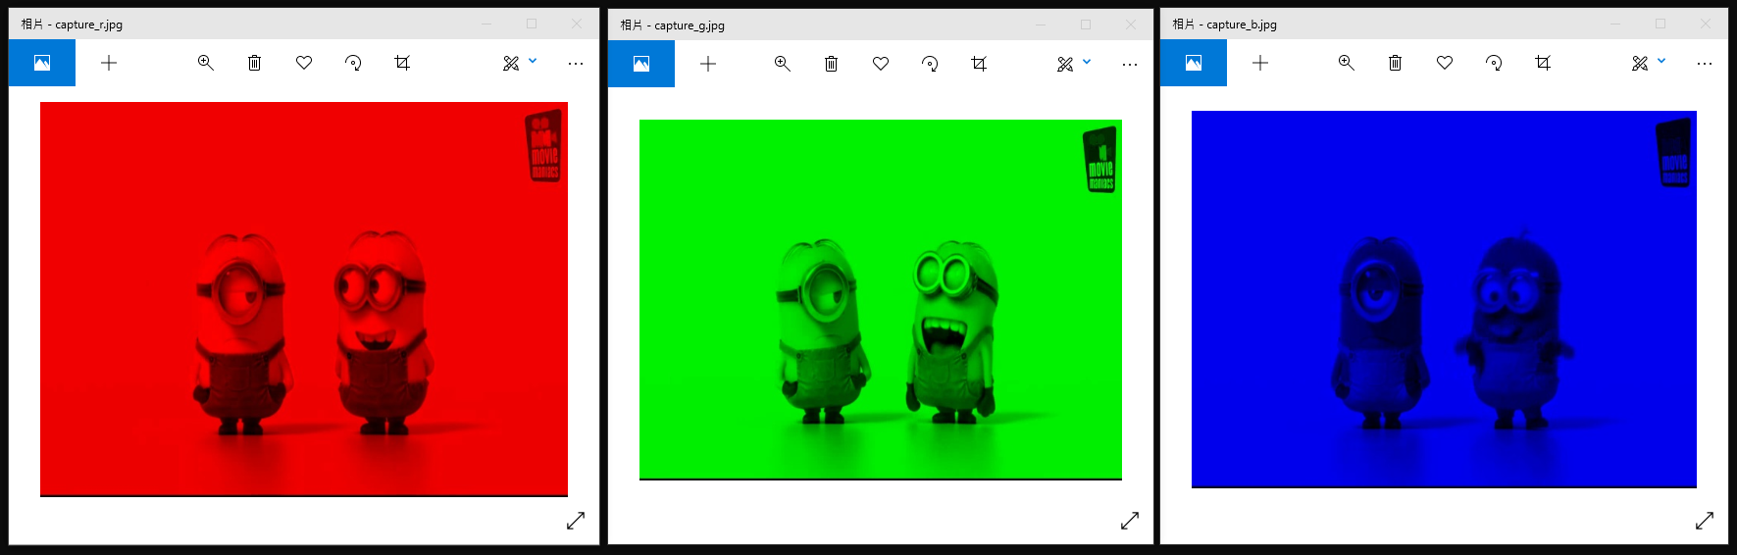
Demo

